Slide 1
Outline
Local importing
→ review and best practices
Packages and editable installations
→ avoid importing errors
Repo structure
→ organize folders and files in a standardized way
Accessibility
→ make code more readable, understandable and usable
Environments
avoid and alleviate package installation problems

Slide 2
make your code self-explanatory

Slide 3
Motivation
You want to make your code as predictable as possible to reduce cognitive effort needed to understand it
if you follow certain rules for writing code, it will become
easier to read and understand
easier to modify
easier to reuse and share

Slide 4
Code smell #1
class Pizza:
name: str
def __init__(self):
self.name = name
def add_toppings(self, toppings):
self.toppings = toppings
import numpy as np
def check_toppings(pizza):
if FORBIDDEN_TOPIC in pizza.toppings:
raise ValueError(“Pineapple cannot be on a pizza
in this restaurant!“)
if __name__ == ”__main__”:
import time
hawaii = Pizza(“Hawaii”)
hawaii.add_toppings([”tomato+mozz”, “pineapple”])
check_toppings(hawaii)
import local_module
FORBIDDEN_TOPPING = “pineapple”

Slide 5
Within-module order
import time
import numpy as np
import local_module
FORBIDDEN_TOPPING = “pineapple”
class Pizza:
name: str
def __init__(self):
self.name = name
def add_toppings(self, toppings):
self.toppings = toppings
def check_toppings(pizza):
if FORBIDDEN_TOPIC in pizza.toppings:
raise ValueError(“Pineapple cannot be on a pizza
in this restaurant!“)
if __name__ == ”__main__”:
hawaii = Pizza(“Hawaii”)
hawaii.add_toppings([”tomato+mozz”, “pineapple”])
check_toppings(hawaii)
imports
standard Python library
installed packages
local modules
Within-module standard order:
2. constants
3. classes, then functions
4. main execution block
if __name__ == "__main__":

Slide 6
Code smell #2
import time
import numpy as np
import local_module
forbiddentopping = “pineapple”
class pizza:
name: str
def __init__(self):
self.name = name
def addtoppings(self, toppings):
self.toppings = toppings
def checktoppings(pizza):
if forbiddentopping in pizza.toppings:
raise ValueError(“Pineapple cannot be
on a pizza in this restaurant!“)
from module import forbiddentopping, checktoppings, pizza

Slide 7
Variable format
import time
import numpy as np
import local_module
FORBIDDEN_TOPPING = “pineapple”
class Pizza:
name: str
def __init__(self):
self.name = name
def add_toppings(self, toppings):
self.toppings = toppings
def check_toppings(pizza):
if FORBIDDEN_TOPPING in pizza.toppings:
raise ValueError(“Pineapple cannot be
on a pizza in this restaurant!“)
from module import FORBIDDEN_TOPPING, check_toppings, Pizza

Slide 8
Variable format
import time
import numpy as np
import local_module
FORBIDDEN_TOPPING = “pineapple”
class Pizza:
name: str
def __init__(self):
self.name = name
def add_toppings(self, toppings):
self.toppings = toppings
def check_toppings(pizza):
if FORBIDDEN_TOPIC in pizza.toppings:
raise ValueError(“Pineapple cannot be on a pizza
in this restaurant!“)
if __name__ == ”__main__”:
hawaii = Pizza(“Hawaii”)
hawaii.add_toppings([”tomato+mozz”, “pineapple”])
check_toppings(hawaii)
imports
Within-module standard order:
2. constants
SCREAMING SNAKE_CASE
3. classes, then functions
ClassName: CamelCase
func_name(): snake_case
variables in functions: snake_case
private variables start with “_“
(cafeful with code completion!)
4. main execution block
if __name__ == "__main__":

Slide 9
Code smell #3
name your variables so that you can later go back and *read* what the code does (same principle as with module names)
x = 10
p = 10
poi = 10
points = 10
points_add = 10
points_to_be_added = 10
x = 10 —> terrible
p = 10 —> just as terrible
poi = 10 —> still terrible
points = 10 —> better, but potentially unspecific
points_add = 10 —> possibly better, possible worse that the one before
points_to_be_added = 10 # clear, but maybe a bit long

Slide 10
Variable names
name your variables so that you can later go back and *read* what the code does (same principle as with module names)
x = 10
p = 10
poi = 10
points = 10
points_add = 10
points_to_be_added = 10
x = 10 —> terrible
p = 10 —> just as terrible
poi = 10 —> still terrible
points = 10 —> better, but potentially unspecific
points_add = 10 —> possibly better, possible worse that the one before
points_to_be_added = 10 # clear, but maybe a bit long
def add(p, e):
x = p + e
return x

Slide 11
Code smells #4, #5, #6
Single responsibility principle
a function/variable/… should do one thing and one thing only
DRY – don‘t repeat yourself
if you are duplicating code, think about taking that part and putting it into a separate function/class/…
Discuss: Where does the code in make_pizzas.py violate this principle?
(5 min)

Slide 12
Notes

Slide 13
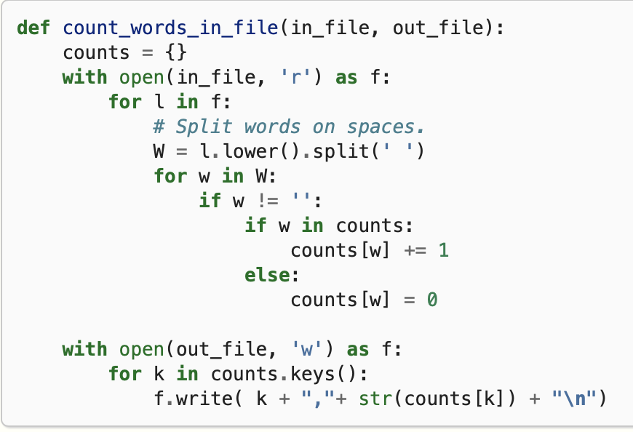
Variable names
name your variables so that you can later go back and *read* what the code does (same principle as with module names)
def long_function(p, e):
x = p + e
return x

Slide 14
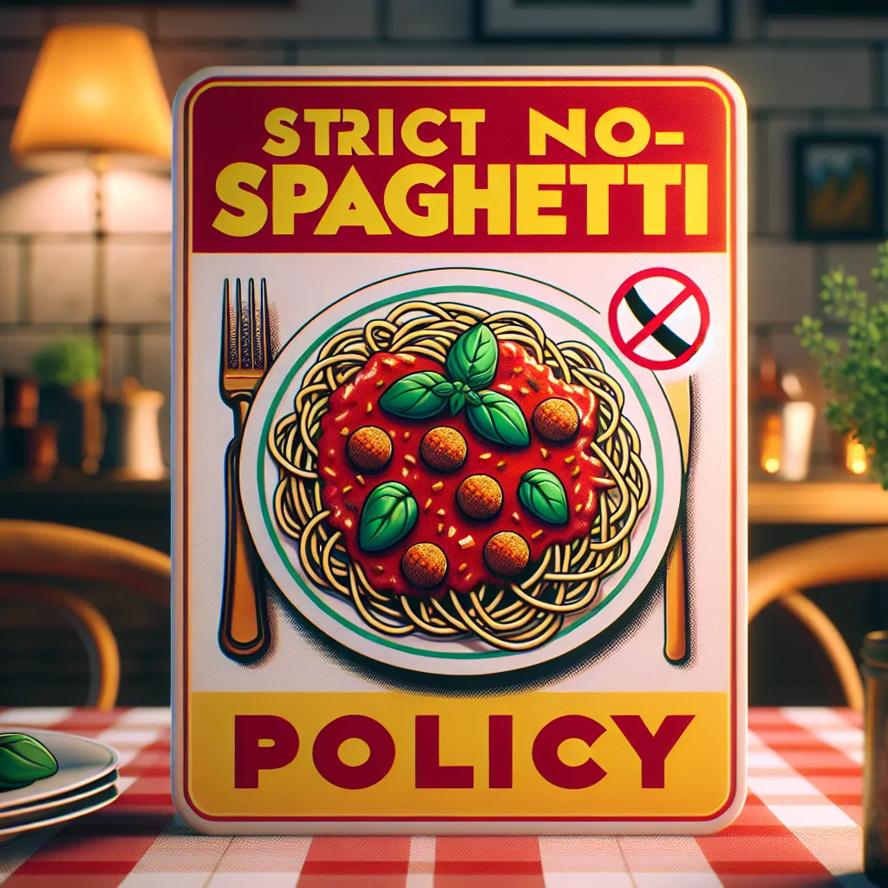
Single responsibility principle
Avoid writing spaghetti code
get rid of code repetitions
make things modular, which leads to reusability
how do you get there?
break up long functions into pieces which vary independently
put code for loading, saving or plotting data in extra functions

Slide 15
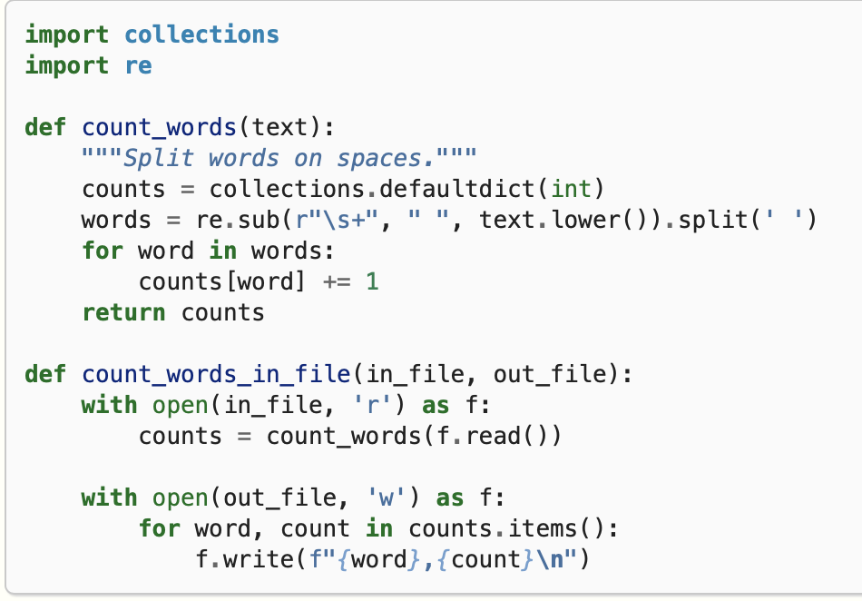
Reduce code complexity
a function should do one thing. Together with descriptive variable names you can later go back and *read* what the code does. This also reduces code complexity.

Slide 16
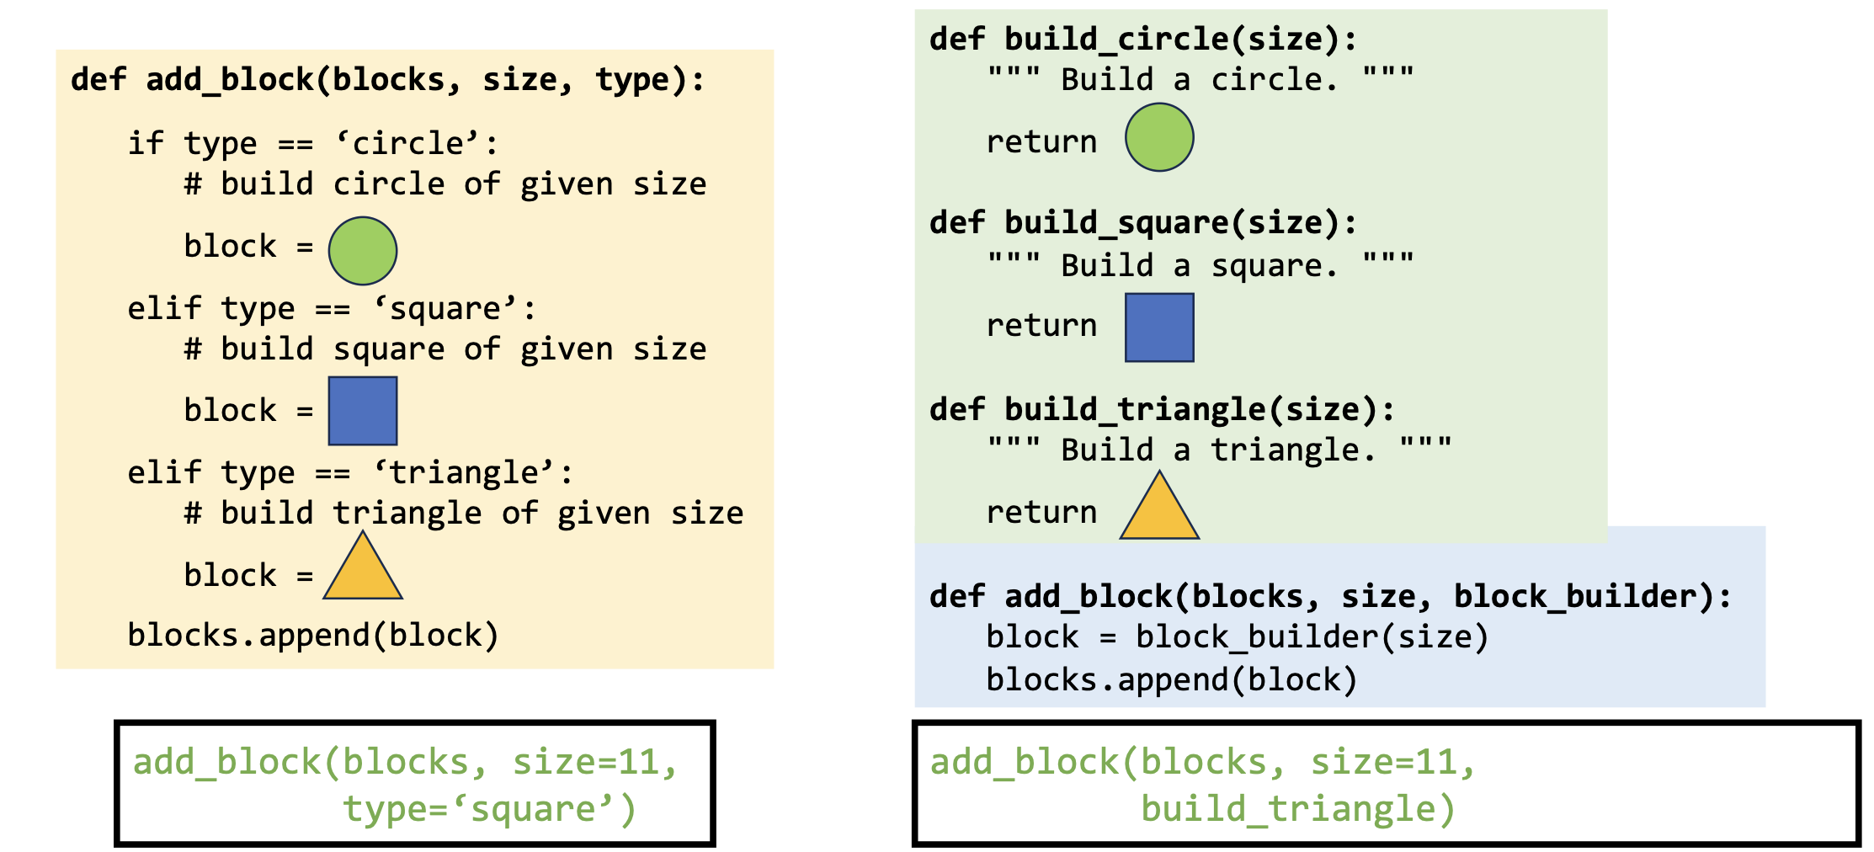
Reduce code complexity II
long if … else … chains are smell of independent code plug-ins

Slide 17
Magic numbers
v = 3.1415 * 4.52843 * 4.52843 * 9.0254
-->
volume = pi * radius**2 * height
can be number, but also string / path
unclear meaning, naming number adds documentation
can be anywhere in the code, therefore hard to maintain (easier to change a number in one place only instead of hunting for all the places it comes up)
but, … not every number or string has to be magic → needs to be readable
fix numbers: x // 2

Slide 18
Towards self-explanatory code
Examples of making functions less spaghetti and more modular and readable
avoid writing spaghetti code
get rid of code repetitions
get rid of code you do not need
make things modular
single responsibility principle
break out things that vary independently
put loading and saving stuff in extra functions, also plotting
magic numbers
nested if and for loops – naming of stuff

Slide 19
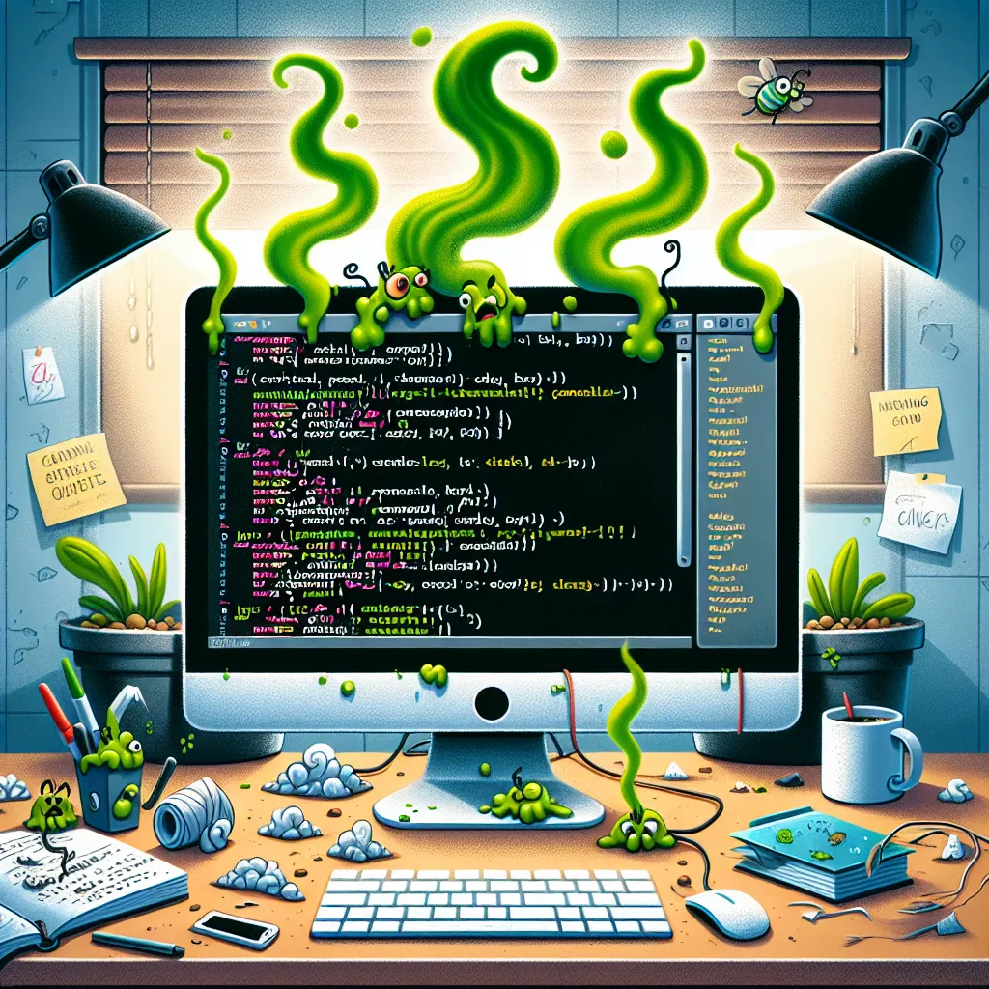
Code smells
Which smells du you recognise from your own code? If you fix them, what do you gain?
imports and other module variables in random order
variables names all look same
variables with mysterious names
large chunks of duplicated code with small tweaks
large functions
highly complex code with many if and for loops
magic numbers
(8 min)

Slide 20
Code smells
imports and other module variables in random order → order to make placement predictable
variables names all look same → format name to immediately recognise functions, classes, constants
variables with mysterious names → choose name to indicate function
large chunks of duplicated code with small tweaks → reduce code duplications be extracting to function/class
large functions → break up big, unwieldy functions which do multiple things into individual functions which each do one thing
highly complex code with many if and for loops → simplify if possible
magic numbers → unique numbers with unclear origin and meaning

Slide 21
Code smell # 8
side effects
Demontrate side effects in functions by modifying an array / data frame that comes in and getting a new list out, but original has also been altered

Slide 22

Towards a more efficient setup
Move away from Jupyter towards an IDE for developing code
Learn how to debug (lets you do everything a jupyter notebook does)
Practice pairing on code
Talk to the duck
Pair programming - remember that everyone has written shitty code in their life

Slide 23
Last words of wisdom
Writing code is more about readability than writing the most beautiful and elegant code possible.
→ writing simple sentences vs. writing poetry

Slide 24
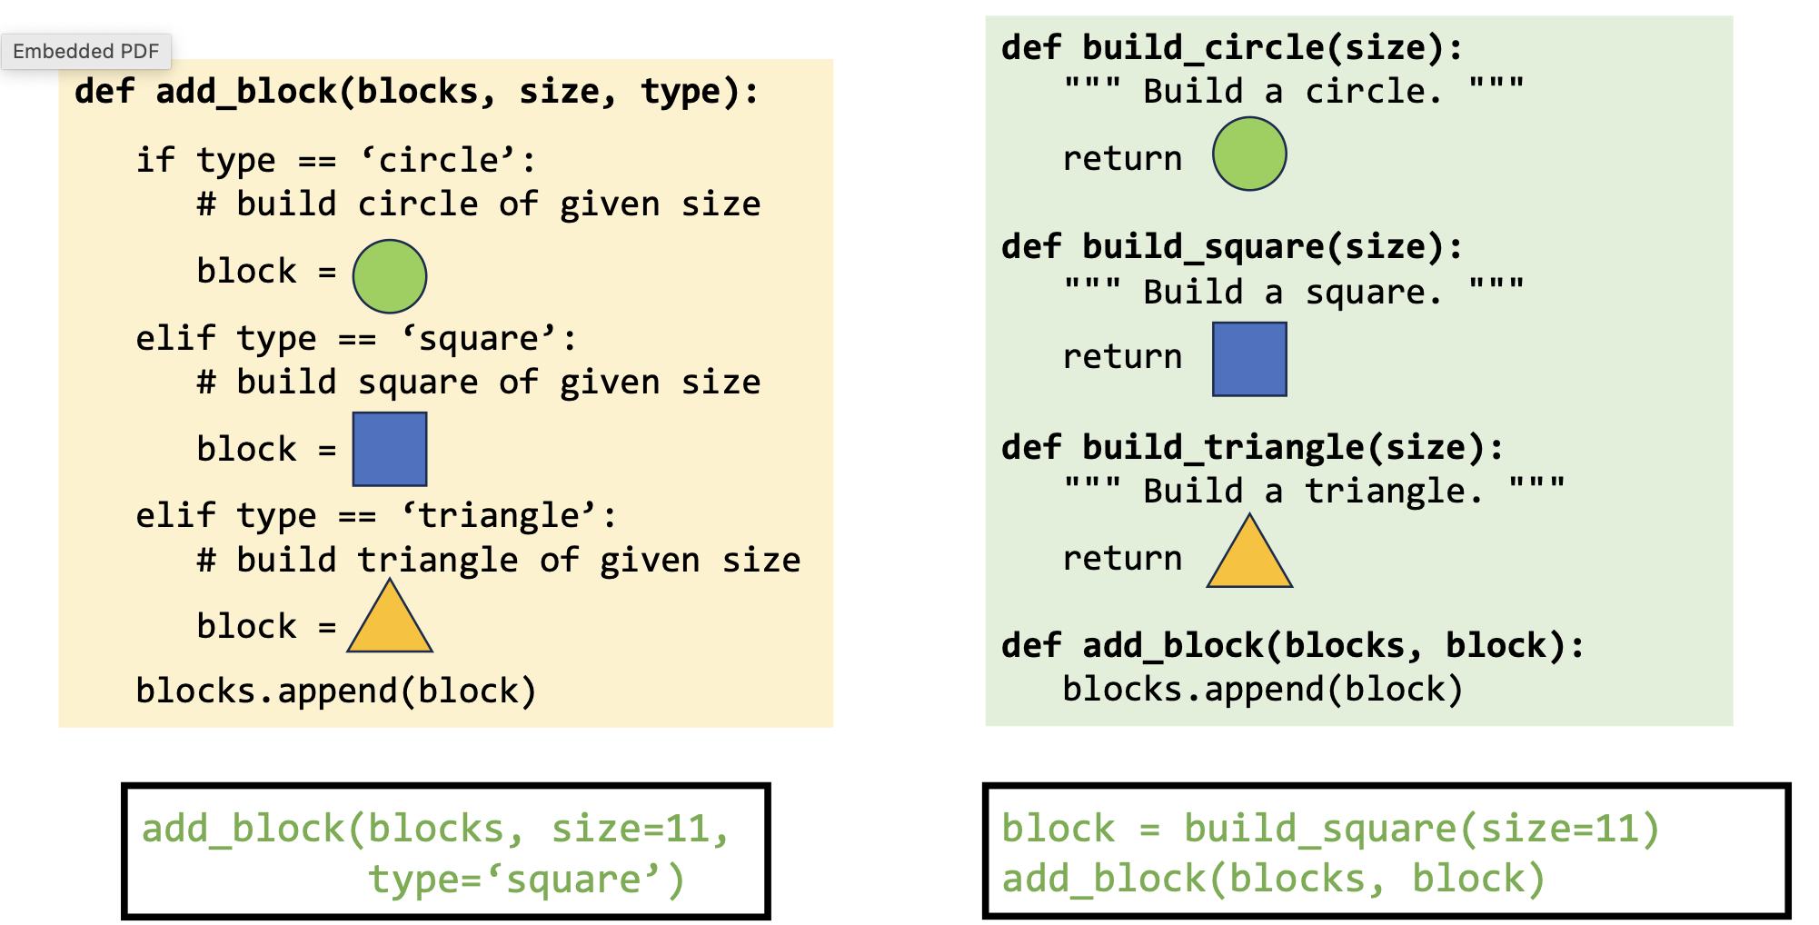
Variable names
added_points = [10, 5, 1]
# —> variable names use underscores
def add_points(house, house_points, points=0):
if house == “Gryffindor”:
points += 1000
return house_points + points
# —> function names also use underscores
class ScoreKeeper():
def __init__(self):
self.house_points = 0
self._secret_bonus = 5
def add_points(self, house, points):
if house == “Gryffindor”:
points += 1000
return house_points + points
# —> Class names use CamelCase
# —> private variables (intended for use only within the class) prepend “_”
if chatgpt tries to import pandas._testing, that is wrong!

Slide 25
accessibility
Notes:
Goal time: 20 minutes (?)

Slide 26
Motivation
Motivation 1. You want to be computationally literate [1].
Three pillars of comp. literacy
Material
Writing a function, using an IDE, etc.
Cognitive
From abstract to computationally tractable.
Social
Community around code.
Motivation 2. You want to make your code easier to understand.
--> Also for future you :)

Slide 27
Accessibility
Two ways to enhance accessibility of your code:
Readability: Adherence to stylistic conventions (PEP8 [2])
Understandability: Comments and docstrings (PEP257 [3])
Spoilers: there are tools to help!

Slide 28

What is PEP
PEP = “Python Enhancement Proposal”
Conventions to standardize python code
Not a standard, not enforced (recommendations/suggestions)
Violating PEP does not break your code (not like div 0)
Aim is to be helpful
Focus for this lecture:
PEP8: Style Guide for Python Code [2]. Code layout, naming conventions, etc.
PEP257: Docstring Conventions [3] - How to document function, classes for user

Slide 29
PEP8
Style Guide for Python Code [2]
“[I]ntended to improve the readability of code and make it consistent across the wide spectrum of Python code.” [2]
Answers questions like:
Should that variable be capitalized or have underscores?
How many spaces should go around an equals sign?
What is the correct order of imports at the top of a file?
Some projects may intentionally not follow PEP8. “Consistency…is the most important.” [2]

Slide 30
Investigate PEP8
Jenni will assign you a letter: A, B, or C. Follow the instructions in Exercise 6a PEP8.
There is no need to make a Pull Request for this exercise.
(10 minutes)

Slide 31
Anything interesting?
Set A
(add in plenum)
Set B
(add in plenum)
Set C
(add in plenum)

Slide 32
Tools to help
PEP8:
pylint.
Static analysis tool.
Informs you of PEP8 violations + other bad-coding practices.
Enable it in your IDE!
ruff.
Python code formatter.
Automatically formats your code to PEP8.
Can enable in your IDE to auto-format on save.

Slide 33
Typing
As of Python 3.5, you can declare the type of the function argument.
There are pros and cons to using typing.
Be aware that this might be a pain to maintain if you change your functions often and pass complicated objects… tuple[int, dict[str, str]]
See PEP484 [4].
""" This module demonstrates docstrings. """
def add_points(house: str,
house_points: int,
points: int = 0)
-> int:
""" Adds up points for house cup.
If the house is Gryffindor, Dumbledore adds
1000 points no matter what.
Parameters
----------
house_points : Current house cup score.
points : optional; New points to be added
"""
if house == “Gryffindor”:
points += 1000
return house_points + points

Slide 34

Typing
As of Python 3.5, you can declare the type of the function argument.
There are pros and cons to using typing.
Be aware that this might be a pain to maintain if you change your functions often and pass complicated objects… tuple[int, dict[str, str]]
See PEP484 [4].

Slide 35

Accessibility
Two ways to enhance accessibility of your code:
Readability: Adherence to stylistic conventions (PEP8 [2])
Understandability: Comments and docstrings (PEP257 [3])
Spoilers: there are tools to help!

Slide 36
Documentation
I could walk you through comments, function docstrings, method docstrings etc. However, you need to consider…
1. Only up-to-date documentation is useful documentation.
2. Once you have finished writing your documentation, it is basically out-of-date if you are not SUPER diligent about updating it.
add comments for explaining tricky pieces of code, for writing down decisions on doing something non-intuitive
→ Try to make your code as self-explanatory as possible!

Slide 37
Documentation
Skip
Documenting your code provides a way of making you code usable for future you and others
Comments (#): describe what a line (or multiple lines of code do); notes to self
Function/method docstring (''' '''): purpose of function + params / return
Module docstring (''' '''): what’s in this file
Accessible via mouse-overs in IDE or help(OBJECT).
""" Module docstring """
def add_points(points, extra_points):
""" Function docstring."""
# comment
points += extra_points
return points

Slide 38
PEP257
Skip
Docstring conventions [3]
You guessed it…guidelines for docstrings.
Answers questions like:
What verb tense should I use for one-liner docstrings?
What indentation should I use within a docstring?
Etc.
I will not drag you through PEP257.

Slide 39
Overloaded
Skip
Skip
We have three new PEPs…
PEP8, PEP257 and PEP484.
Remembering all these rules is too much.
→ Static analysis tools!
[6]

Slide 40


Tools to help
Skip
PEP8:
pylint.
Static analysis tool.
Informs you of PEP8 violations + other bad-coding practices.
Enable it in your IDE!
ruff.
Python code formatter.
Automatically formats your code to PEP8.
Can enable in your IDE to auto-format on save.
PEP257:
pydocstyle.
Static analysis tool.
Checks compliance with PEP257.
autoDocstring.
VS code plug-in to auto-generate docstring based on inputs, outputs.
PEP484:
mypy.
Static type checker for Python.
Checks compliance with PEP484 (and more).

Slide 41
Accessibility
Skip
Two ways to enhance accessibility of your code:
Readability: Adherence to stylistic conventions (PEP8 [2])
Understandability: Comments and docstrings (PEP257 [3])
Spoilers: there are tools to help!

Slide 42
Extra material

Slide 43
Keeping track of docstrings
Most commonly used hosting websites: facilitate building, versioning, and hosting
github.io
readthedocs.org
Automate documentation
Sphinx: a package to collect docstrings and create a nicely formatted documentation website

Slide 44
References
DiSessa, Andrea A. Changing minds: Computers, learning, and literacy. Mit Press, 2000.
PEP 8 – Style Guide for Python Code | peps.python.org
PEP 257 – Docstring Conventions | peps.python.org
PEP 484 – Type Hints | peps.python.org
Example NumPy Style Python Docstrings
Dizzy 2 (Animation GIF) by QToons on DeviantArt

Slide 45
Contents
usability features:
1) separate, individually usable projects
virtual environments
2) clean folder and file structure
standard Python package structure
3) error-free importing of code
editable pip installation
4) readability
documentation, typing, naming

Slide 46
References
https://journals.plos.org/plosbiology/article?id=10.1371/journal.pbio.1001745
https://journals.plos.org/ploscompbiol/article?id=10.1371/journal.pcbi.1005510#pcbi.1005510.ref001
https://goodresearch.dev/

